Slide 1
Deep Learning Seminar Day-1

Slide 2
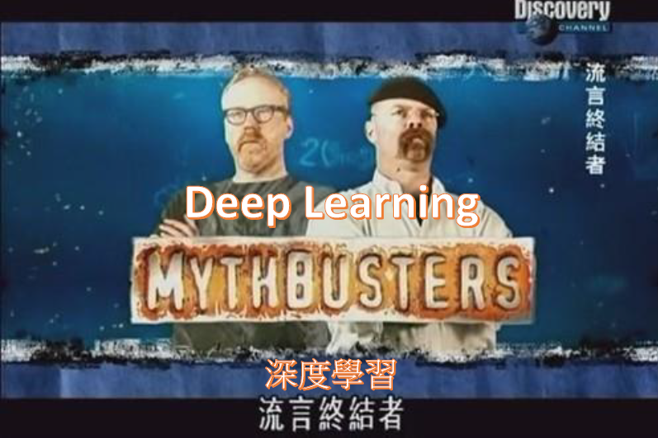
Deep Learning: Hype or Reality?

Slide 3
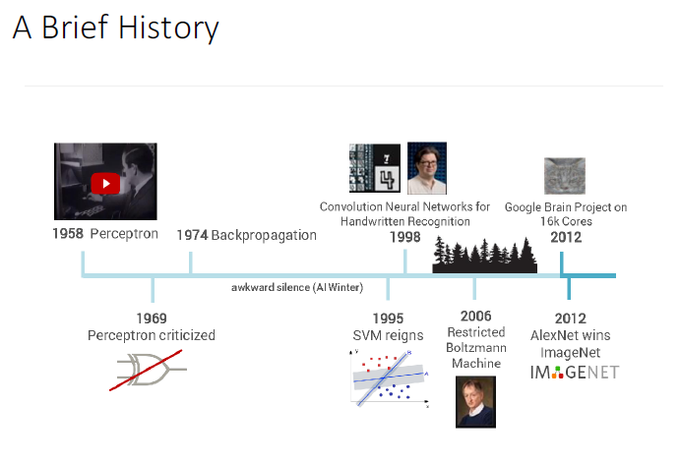
Deep Learning: Hype or Reality?
Deep Learning using TensorFlow and TensorFlow-Slim
Dipendra Jha Northwestern University

Slide 4
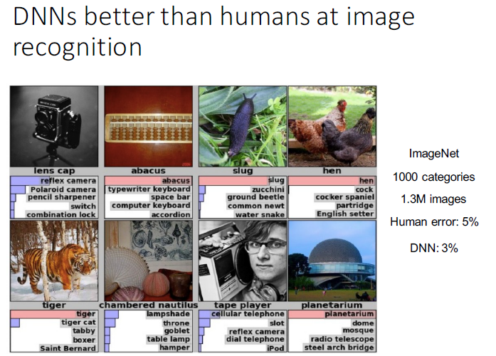
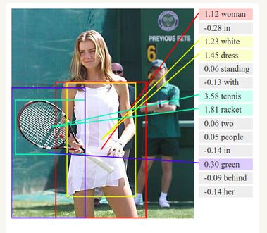
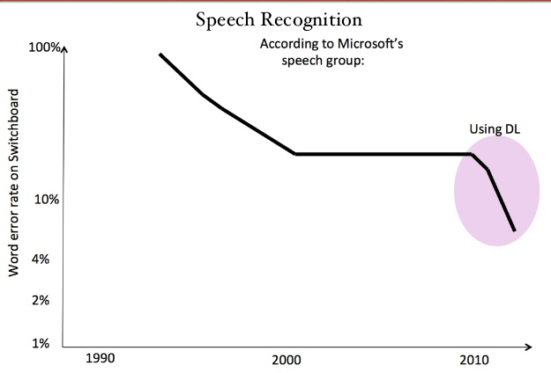

Deep Learning: Hype or Reality?

Slide 5
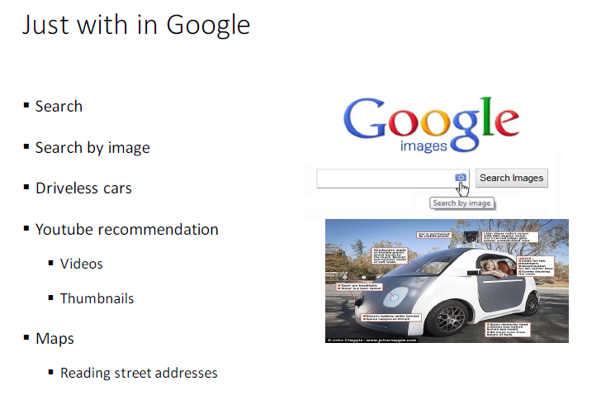
Deep Learning: Hype or Reality?

Slide 6
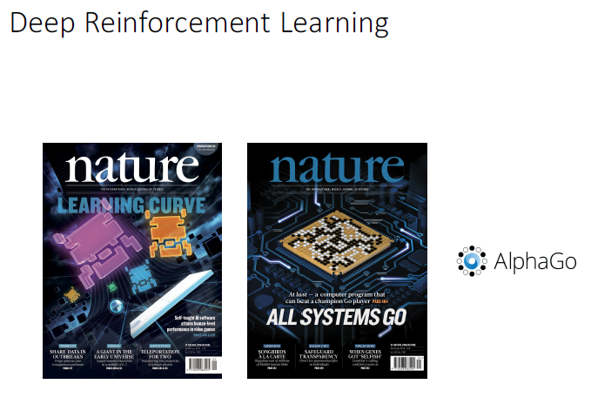
Deep Learning: Hype or Reality?
…going unsupervised! Deep Clustering

Slide 7

Reinforcement Learning: learning by trial-and-error… from rewards or punishments…
In “Nature” 27 January 2016:
“DeepMind’s program AlphaGo beat Fan Hui, the European Go champion, five times out of five in tournament conditions...”
“AlphaGo was not preprogrammed to play Go: rather, it learned using a general-purpose algorithm that allowed it to interpret the game’s patterns.”
“…AlphaGo program applied deep learning in neural networks (convolutional NN) — brain-inspired programs in which connections between layers of simulated neurons are strengthened through examples and experience.”

Slide 8
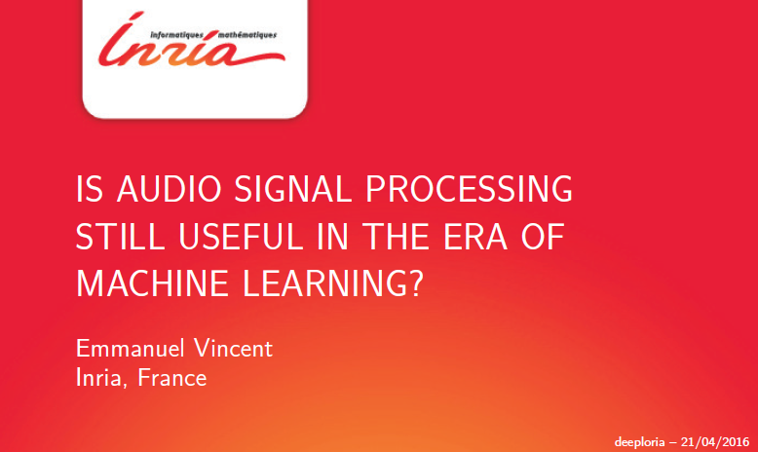
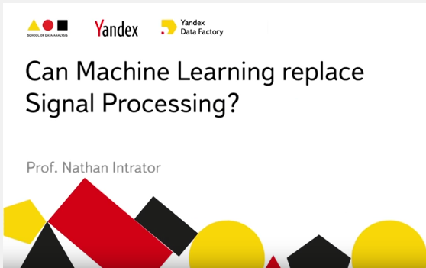
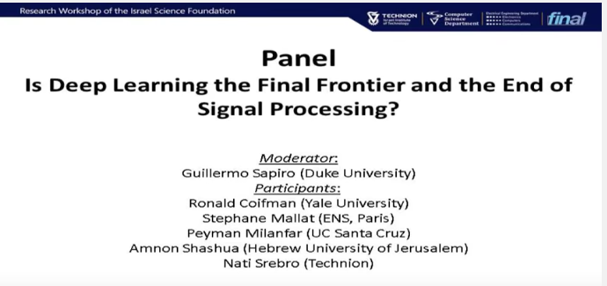
Deep Learning and (v.s. ?) Signal Processing

Slide 9
Introduction to Deep Learning What and Why?
So, 1. what exactly is deep learning ?
And, 2. why is it generally better than other methods on image, speech and certain other types of data?
The short answers
What: ‘Deep Learning’ means using a neural network
with several layers of nodes between input and output
Why: the series of layers between input & output do
feature identification and processing in a series of stages,
just as our brains seem to.

Slide 10
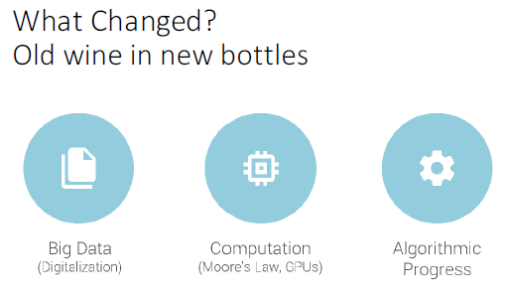

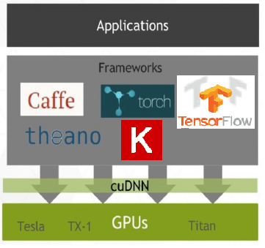

Introduction to Deep Learning but what is new?

Slide 11
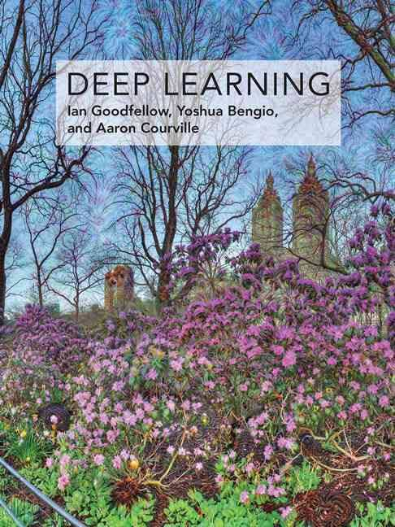
Introduction to Deep Learning …the Machine Learning background…
Learn the whole
Machine Learning context
On line:
www.deeplearningbook.org
Deep Learning courses
Prof. Hung-yi Lee National Taiwan University (NTU) Taipei

Slide 12
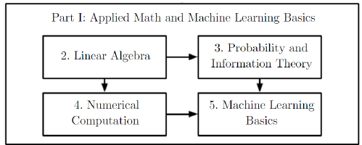
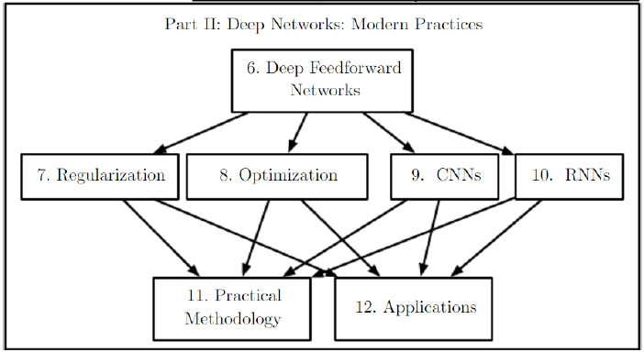
Introduction to Deep Learning …the Machine Learning background…

Slide 13
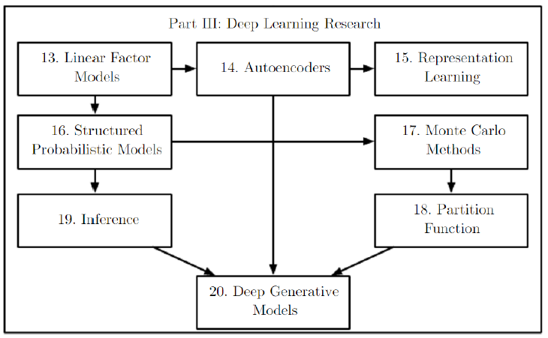
Introduction to Deep Learning …the Machine Learning background…

Slide 14
Introduction to Deep Learning …the Machine Learning background…

Slide 15
FROM : humans
to machines
to Artificial Intelligence (AI)

Slide 16
… so we will proceed
FROM:
manual classifiers
linear classifiers
TO:
Neural Networks

Slide 17
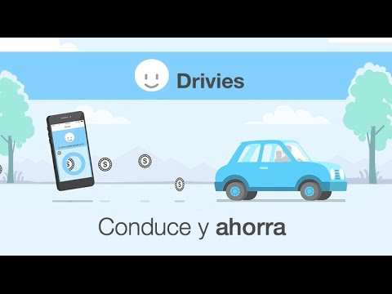
Drivies use case:
www.driviesapp.com

Slide 18
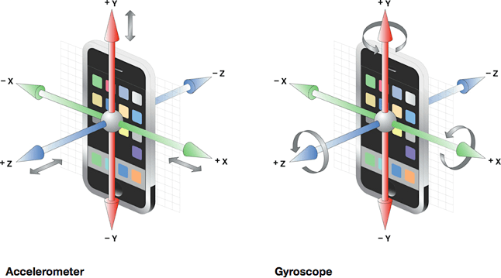

Slide 20
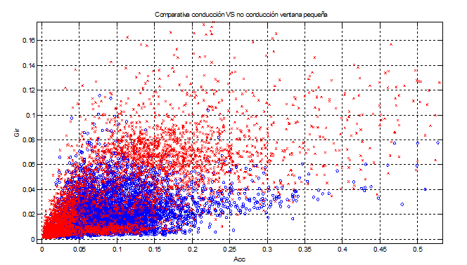
From manual - linear classifiers TO Neural Networks

Slide 21
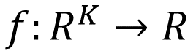
Driving detection (yes/no)
= define a decision function
No-driving=0
$$f:R^{K}→R$$
Driving=1

Slide 22
From linear classifiers TO Neural Networks
A Linear decision function
…
weights
bias

Slide 23
From linear classifiers TO Neural Networks
A Linear decision function

Slide 24
From linear classifiers TO Neural Networks
Nonlinear decision function?
No-driving=0
$$f:R^{K}→R$$
Driving=1

Slide 25
Non-linear decision functions
A linear model of transformed inputs:

Slide 26
How choosing the mapping ?
Use a very generic as kernel machines (e.g. SVM, RBF kernel)
To manually engineer
The strategy of deep learning : to learn

Slide 27
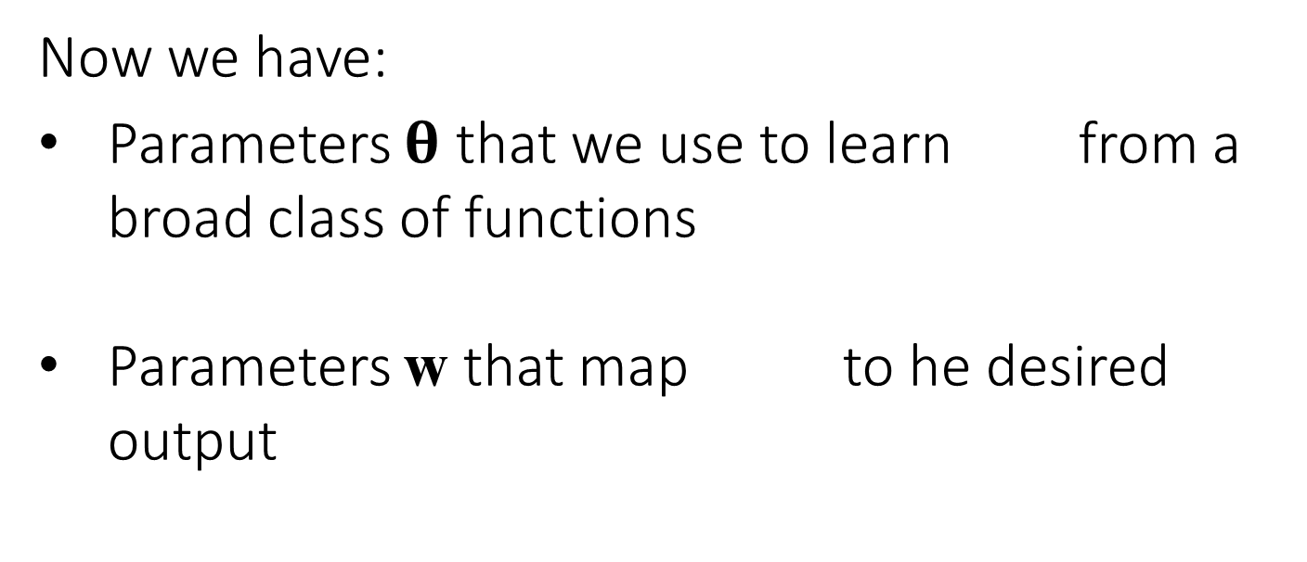
The DL approach: learn
Now we have:
Parameters $θ$ that we use to learn from a broad class of functions
Parameters w that map to he desired output

Slide 28
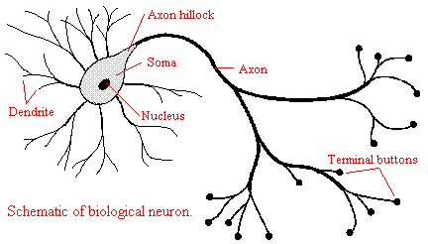
The DL approach: learn
…from a broad class of functions

Slide 29
Neuron approach….
…
Cumulative
influence
synaptic weights
Activation
Function
“all or none”

Slide 30
Neural Network (from Hung-yi Lee “Deep Learning Tutorial”)
neuron
Input
Layer 1
Layer 2
Layer L
Output
……
y₁
……
y₂
……
……
……
……
……
……
y_{M}
Input Layer
Output Layer
Hidden Layers
Deep means many hidden layers

Slide 31
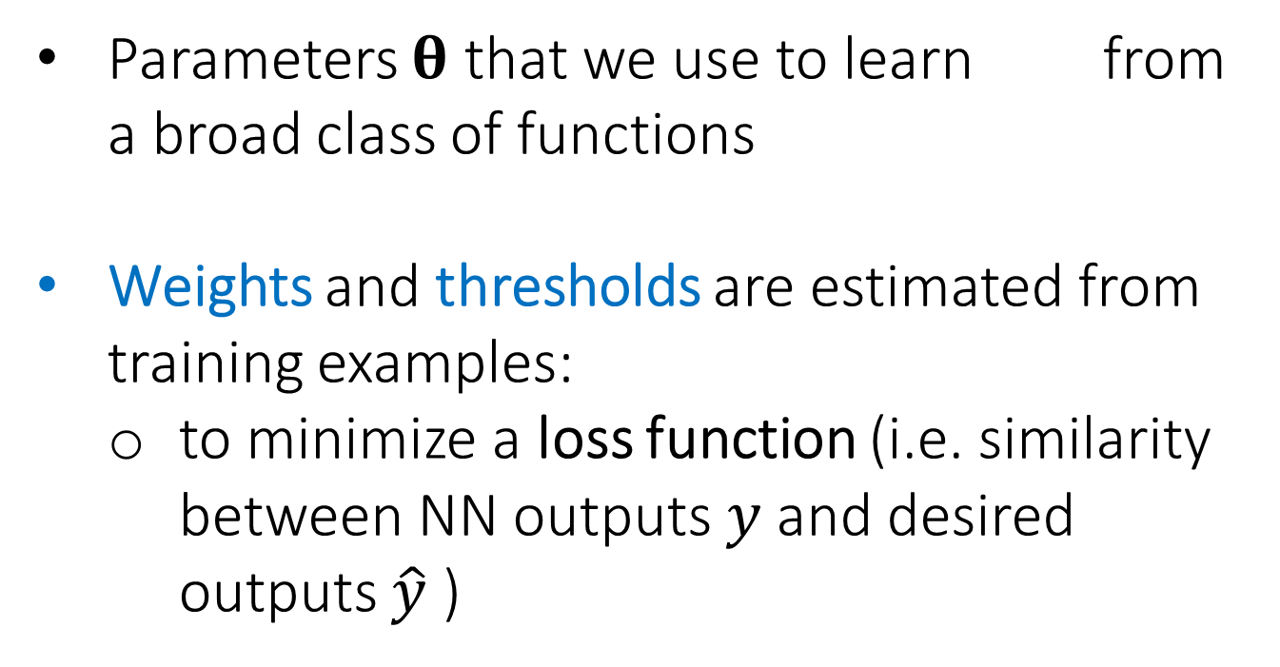
From linear classifiers TO Neural Networks
Parameters $θ$ that we use to learn from a broad class of functions
Weights and thresholds are estimated from training examples:
to minimize a loss function (i.e. similarity between NN outputs $y$ and desired outputs $\hat{y}$ )

Slide 32
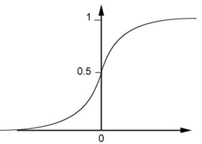
…
… gradients!
continuous activation!
…25 years… Paul J. Werbos (1974)
…as Sigmoid function
weights
Threshold
Sigmoid Function
bias

Slide 33
But recall that this is also logistic regression!
…
weights

Slide 34

From linear classifiers TO Neural Networks
So let’s stop here and start playing with
Notes:
Fully Connected Feedforward Network
You can always connect the neurons in your own way.
“+” is ignored
Each dimension corresponds to a digit (10 dimension is needed)

Slide 35

Google TensorFlow
Library for writing “machine intelligence” algorithms
Very popular for deep learning and neural networks
Can also be used for general purpose numerical computations
Interface in C++ and Python

Slide 36
Generates a computational graph like Theano
Everything about TensorFlow is here:
https://www.tensorflow.org
Inputs
Outputs
weights
variables
constants
Computational
graph
bias

Slide 37
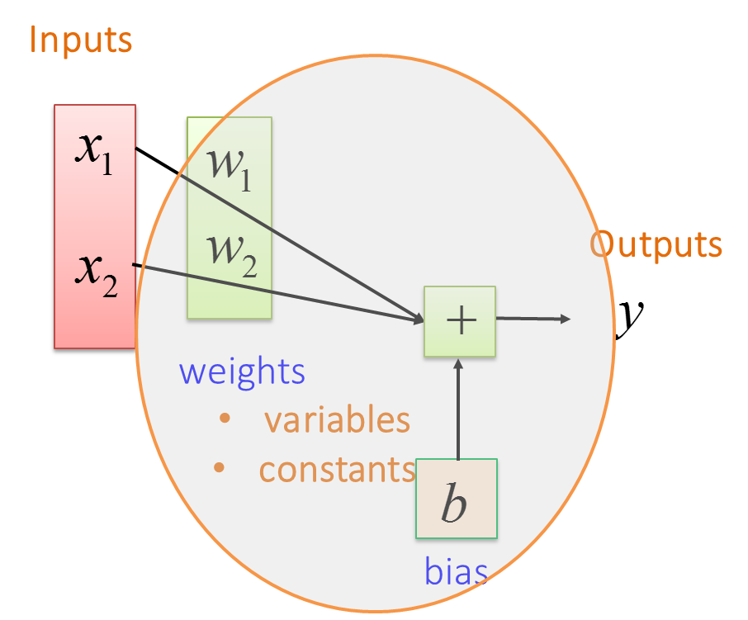
TensorFlow Recipe:
Define a series of expressions
Initialize variables
Start a session (launch a graph)
Run the graph, feed some data, fetch some values

Slide 38
TensorFlow Essentials:
Four types of objects make TensorFlow unique from other frameworks
Session
Computational graph
Variables
Placeholder

Slide 39
Let’s start playing with !!
Where? IBM DSX or your own (be carefull with TF versions!!)
How: we have prepared some Interactive Python notebooks (Jupyter) http://jupyter.org/about.html
MSTC_IntroTF_1.ipynb

Slide 40
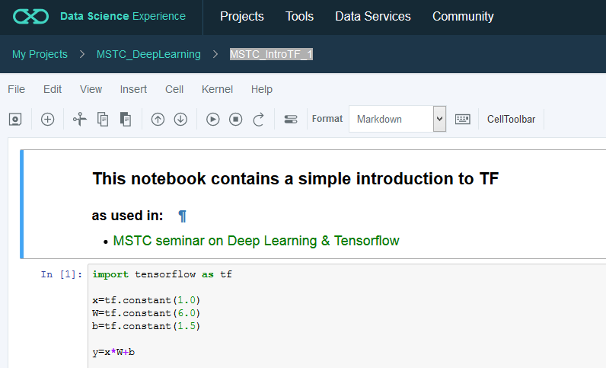
https://github.com/MasterMSTC/DeepLearning_TF/
MSTC_IntroTF_1.ipynb

Slide 41
TensorFlow Docs:
“TensorFlow programs are usually structured into a construction phase, that assembles a graph…”
import tensorflow as tf
x=tf.constant(1.0)
W=tf.constant(6.0)
b=tf.constant(1.5)
y=x*W+b
print(y)
Tensor("add:0", shape=(), dtype=float32)

Slide 42
TensorFlow Docs:
“A Session object encapsulates the environment in which Tensor objects are evaluated…”
“..and an execution phase that uses a session to execute ops in the graph”
import tensorflow as tf
x=tf.constant(1.0)
W=tf.constant(6.0)
b=tf.constant(1.5)
y=x*W+b
with tf.Session() as sess:
print(sess.run(y))
7.5

Slide 43
TensorFlow Variables
“… hold and update parameters”
..and graph (session) is executed several times
W=tf.Variable(tf.random_uniform([1], -1.0, 1.0))
b=tf.Variable(tf.zeros([1]))
x=tf.constant(1.0)
# Before starting, initialize the variables
init = tf.global_variables_initializer()
y=x*W+b
with tf.Session() as sess:
sess.run(init)
for step in range(4):
print(sess.run(y))

Slide 44
TensorFlow Placeholders
“… dummy nodes that provide entry points to the computational graph”
W=tf.Variable(tf.random_uniform([1], -1.0, 1.0))
b=tf.Variable(tf.zeros([1]))
x=tf.placeholder(tf.float32)
# Before starting, initialize the variables
init = tf.global_variables_initializer()
y=x*W+b
with tf.Session() as sess:
sess.run(init)
for step in range(4):
print(sess.run(y, feed_dict=(x:1)))

Slide 45
Why TensorFlow?
Python + Numpy
Graph based, easy to model
Faster compile times than Theano
Tensorboard for Visualization
Open Sourced
Data and Model Paralllelism
Distributed supported

Slide 46
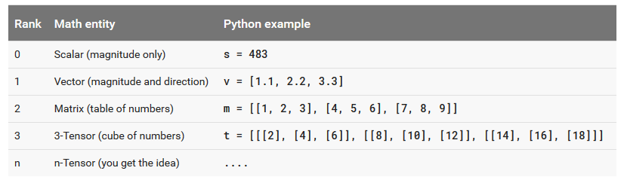
But what’s a Tensor?
Tensor Ranks, Shapes, and Types
Briefly: A tensor is an array of n-dimension containing the same type of data
Tensor rank (sometimes referred to as order or degree or n-dimension) is the number of dimensions of the tensor.

Slide 47
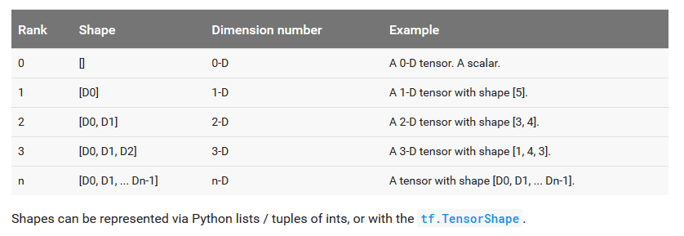
But what’s a Tensor?
Tensor Ranks, Shapes, and Types
Tensor shape: The TensorFlow documentation uses three notational conventions to describe tensor dimensionality: rank, shape, and dimension number.

Slide 48
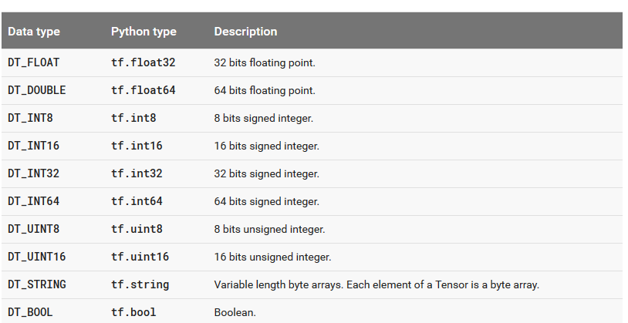
But what’s a Tensor?
Tensor Ranks, Shapes, and Types
……..
…………..

Slide 49
But what’s a Tensor?
A Tensor in TensorFlow has 2 shapes! The static shape AND the dynamic shape
The static shape can be read using the tf.Tensor.get_shape() method: this shape is inferred from the operations that were used to create the tensor, and may be partially complete.
x = tf.placeholder(tf.int32, shape=[4])
print x.get_shape()
# ==> '(4,)‘
If the static shape is not fully defined, the dynamic shape of a Tensor t can be determined by evaluating tf.shape(t).
y, _ = tf.unique(x)
print y.get_shape()
# ==> '(?,)'

Slide 50
But what’s a Tensor?
A Tensor in TensorFlow has 2 shapes! The static shape AND the dynamic shape
getting dynamic shape of a Tensor t can be determined by evaluating tf.shape(t).
y, _ = tf.unique(x)
sess = tf.Session()
print sess.run(y, feed_dict={x: [0, 1, 2, 3]}).shape
# ==> '(4,)‘
print sess.run(y, feed_dict={x: [0, 0, 0, 0]}).shape
# ==> '(1,)'

Slide 51
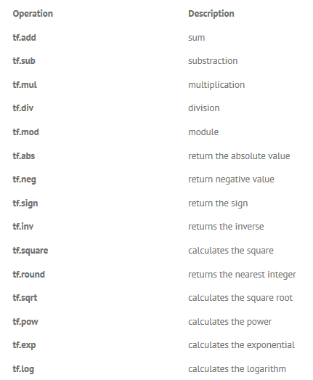
But what’s a Tensor?
mathematical operations to manipulate the tensors
………..

Slide 52
But what’s a Tensor?
Dealing with shapes is one of the major issues when working with TensorFlow!

Slide 53
Placeholders: Feeding data…
tf.placeholder()
Arguments: data type (mandatory), shape (optional), name (optional)
Specifying (the entirety or part of) shape restricts shapes of possible inputs to the node
At run time, we feed using a feed_dic
Placeholders allow you to pass in numpy arrays of data

Slide 54
Let’s try a simple linear classifier
Inputs
Outputs
weights
variables
constants
bias

Slide 55
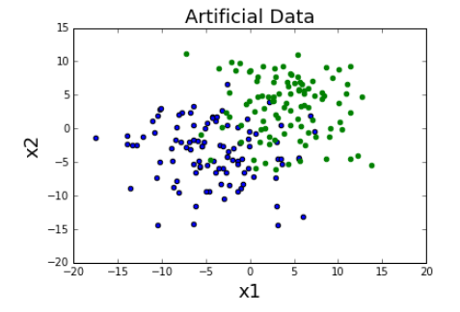
Binary (two-class) classifier
from synthetic data

Slide 56
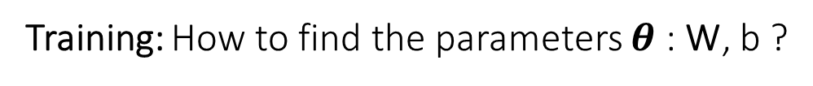
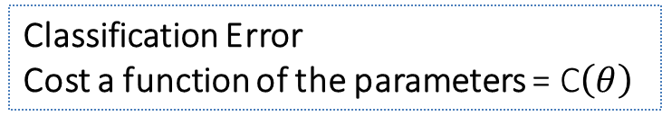
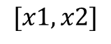
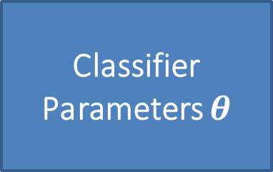
Binary (two-class) classifier
from synthetic data
Training: How to find the parameters $θ$ : W, b ?
True class
Classifier
Parameters $θ$
$$[x1, x2]$$
Output
Classification Error
Cost a function of the parameters = C$\left(θ\right)$
OPTIMIZATION =>

Slide 57
MSTC_IntroTF_2.ipynb

Slide 58
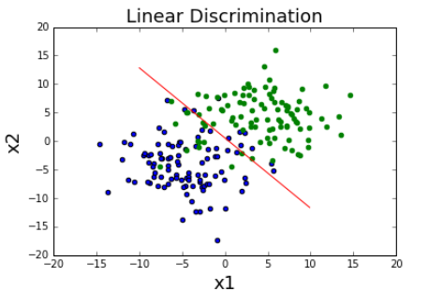
For particular values of W and b:
Red line is the set of points defined by:
… arbitrary ….

Slide 59
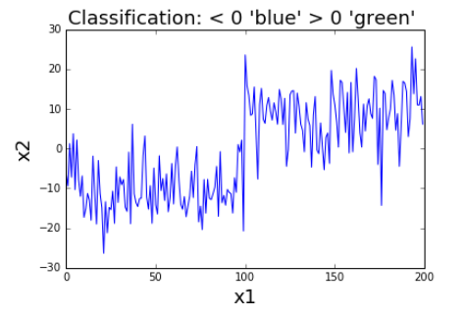
Green points will give:
Blue points will give:

Slide 60
Next Slides are from: Deep Learning Tutorial
李宏毅
Hung-yi Lee
Notes:
Not memtion
DT v.s. Deep!!!!!

Slide 61
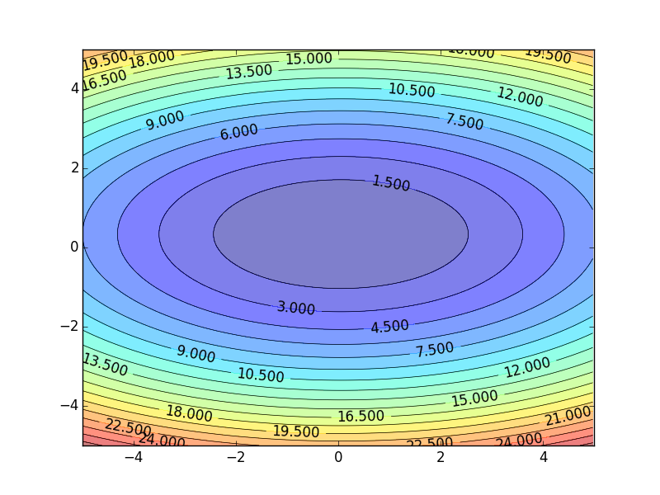
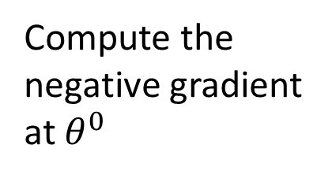
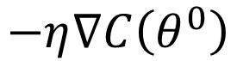
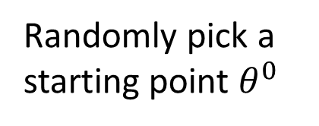
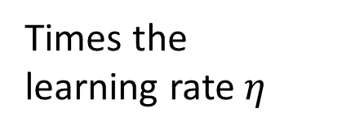

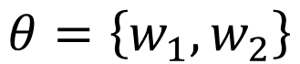
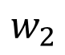

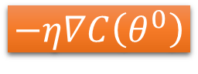

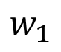
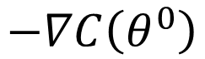
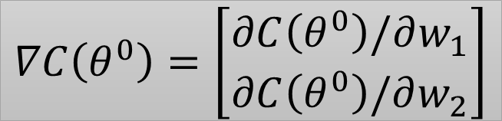
Gradient Descent
OPTIMIZATION
Assume there are only two parameters w₁ and w₂ in a network.
Error Surface
$$θ=\left\{w_{1},w_{2}\right\}$$
Colors represent the value of C(𝜃)
Randomly pick a starting point $θ^{0}$
Compute the negative gradient at $θ^{0}$
$$w_{2}$$
$$θ^{∗}$$
$$−η∇C\left(θ^{0}\right)$$
$$−∇C\left(θ^{0}\right)$$
$$−∇C\left(θ^{0}\right)$$
Times the learning rate $η$
$$∇C\left(θ^{0}\right)=\left[\begin{matrix}∂C\left(θ^{0}\right)/∂w_{1} \\ ∂C\left(θ^{0}\right)/∂w_{2}\end{matrix}\right]$$
$$θ^{0}$$
$$−η∇C\left(θ^{0}\right)$$
$$w_{1}$$
Notes:
Eta
人站在 ｔｈｅｔａ０ 環顧四周 看看哪裡最低，那個方向就是 ｇｒａｄｉｅｎｔ

Slide 62
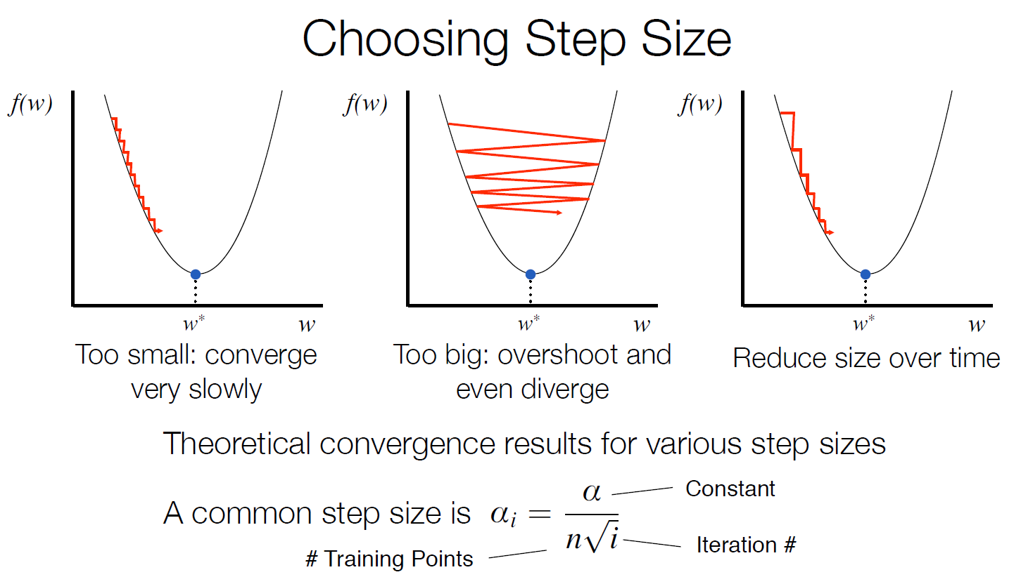

Source:

Slide 63

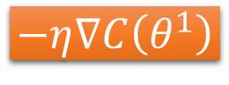





Gradient Descent
Eventually, we would reach a minima …..
Randomly pick a starting point $θ^{0}$
Compute the negative gradient at $θ^{0}$
$$θ^{2}$$
$$−η∇C\left(θ^{2}\right)$$
$$−η∇C\left(θ^{1}\right)$$
$$w_{2}$$
$$−∇C\left(θ^{2}\right)$$
$$−∇C\left(θ^{1}\right)$$
$$θ^{1}$$
$$−∇C\left(θ^{0}\right)$$
Times the learning rate $η$
$$θ^{0}$$
$$−η∇C\left(θ^{0}\right)$$
$$w_{1}$$

Slide 64





Local Minima
Gradient descent never guarantee global minima
Different initial point $θ^{0}$
Reach different minima, so different results
$$C$$
Who is Afraid of Non-Convex Loss Functions?
http://videolectures.net/eml07_lecun_wia/
$$w_{1}$$
$$w_{2}$$

Slide 65



Besides local minima ……
cost
Very slow at the plateau
Stuck at saddle point
Stuck at local minima
$$∇C\left(θ\right)≈0$$
$$∇C\left(θ\right)=0$$
$$∇C\left(θ\right)=0$$
parameter space

Slide 66
In physical world ……
Momentum
How about put this phenomenon in gradient descent?
Notes:
Momentum: 動量

Slide 67
Momentum
Still not guarantee reaching global minima, but give some hope ……
cost
Movement =
Negative of Gradient + Momentum
Negative of Gradient
Momentum
Real Movement
Gradient = 0
Notes:
What can we see?

Slide 68
What Cost Function ?
Classification error (number of errors)? How derivate? gradient?
Better think on terms of probability & look for nice ways to derivate…

Slide 69


From scores to probabilities:
Binary classification is easy: use sigmoid or logistic function

Slide 70

For multiclass classification:
Similar procedure using Softmax function

Slide 71

Digits recognition
Output layer
……
z₁
……
z₂
……
……
……
……
……
z_{M}
16 x 16 = 256
Ink → 1
No ink → 0
In general, the output of network can be any value z_{i}
May not be easy to interpret

Slide 72

Softmax
Probability:
$1>y_{i}>0$
$\sum_{i}{y_{i}=1}$
Softmax layer as the output layer
Softmax Layer
3
20
0.88
1
2.7
0.12
-3
0.05
≈0
Notes:
Why it is name soft max?
Monotonicity of softmax
Non-locality of softmax

Slide 73

Softmax layer
Output
Probabilities
……
y₁
is 1
0.1
……
y₂
0.7
is 2
Softmax
……
……
……
……
……
y₁₀
is 0
0.2

Slide 74
Cost function:
How to measure accuracy?
Cross-entropy
and
Maximum Likelihood Estimation

Slide 75

Intuitive approach for a two-class (binary) classifier
Take a data set:
$\left\{x_{n},l_{n}\right\}$ of $N$ vectors $x_{n}$ belonging to two classes (labels $l_{n}$ =0,1)
Consider our classifier as an estimator of the conditional probability:
$p(l_{n}=1|x_{n}$) = $p_{1n}$
…and so… $p(l_{n}=0|x_{n}$) = 1 - $p_{1n}$

Slide 76

A PERFECT classifier
If $l_{n}$=1 then $p(l_{n}=1|x_{n}$) = $p_{1n}$=1
If $l_{n}$=0 then $p(l_{n}=1|x_{n}$) = $p_{1n}$=0
In a single expression:
$p_{1n}^{l_{n}}{\left(1−p_{1n}\right)}^{\left(1−l_{n}\right)}$
In a perfect classifier this must be:
a “probability” always 1 for every data n!!!

Slide 77



A PERFECT classifier
All the probabilities/likelihood for each sample should be 1
Maximum Likelihood estimation of $θ$
$${{θ_{ML}=\prod_{n=1}^{N}{p_{1n}^{l_{n}}{\left(1−p_{1n}\right)}^{\left(1−l_{n}\right)}}}_{}}_{}^{}$$
From that a Cost Function can be obtained taking: the negative logarithm = Cross-entropy
$$Cross entropy=−\sum_{n=1}^{N}{(l_{n}\log\left(p_{1n}\right)+\left(1−l_{n}\right)\log\left(1−p_{1n}\right))}$$

Slide 78


Cross entropy loss function
From Maximum Likelihood to Minimum Cross-entropy
$$Cross entropy=−\sum_{n=1}^{N}{(l_{n}\log\left(p_{1n}\right)+\left(1−l_{n}\right)\log\left(1−p_{1n}\right))}$$
Shannon entropy $H(.)$: of uncertainty in a probability distribution P
$$H\left(x\right)=−E_{x\sim P}\left[\log\left(P\left(x\right)\right)\right]$$
Cross-entropy (two distributions : $P﷮data$ and $P﷮model$)
$$−E_{x\sim P_{data}}\left[\log\left(P_{model}\left(x\right)\right)\right]$$

Slide 79


Now let’s feed our Training data to a simple linear classifier
Inputs
Train data
Session:
Outputs
weights
Probabilities
Cross entropy
bias

Slide 80
W=tf.constant([[1.23], [1.0]],name="weights")
b=tf.constant(-0.55,name="bias")
Inputs
X = tf.placeholder("float", shape=[None, 2]
Train data
labels = tf.placeholder("float", shape=[None])
Session:
Outputs
# Predictor is now the logistic function
pred = tf.sigmoid(tf.to_double(tf.reduce_sum(tf.matmul(X, W), axis=[1]) + b))
# Cost function is cross-entropy
cost = -tf.reduce_sum(tf.to_double(labels) * tf.log(pred) + (1-tf.to_double(labels)) * tf.log(1-pred))
weights
Probabilities
Cross entropy
bias

Slide 81
with tf.Session() as sess:
sess.run(init)
pred, cost=sess.run(pred, cost, feed_dict={X: train_X})
Inputs
Train data
Session:
Outputs
weights
Probabilities
Cross entropy
bias

Slide 82
Check that our results are the same as before

Slide 83
Now let’s train!:
W and b will be variables (tensors)
W = tf.Variable(tf.zeros([2, 1], "float"), name="weight")
b = tf.Variable(tf.zeros([1], "float"), name="bias")
and we use cross-entropy and gradient descend
cost = -tf.reduce_sum(tf.to_double(labels) * tf.log(pred) + (1-tf.to_double(labels)) * tf.log(1-pred))
# Gradient descent
learning_rate = 0.001
optimizer = tf.train.GradientDescentOptimizer(learning_rate).minimize(cost)

Slide 84
We have used all the training data several runs (Epochs)
with tf.Session() as sess:
sess.run(init)
# We can Run the optimization algorithm several times
for i in range(100):
cost_out,W_out,b_out,_=sess.run([cost, W,b, optimizer], feed_dict={X: train_X, labels: train_labels})
print("Epoch : %d Cost= %s "%(i,cost_out))
print(W_out)
print(b_out)

Slide 85
When large amounts of data divide data into mini-batches
Most optimization algorithms converge much faster (in terms of total computation, not in terms of number of updates) if they are allowed to rapidly compute approximate estimates of the gradient rather than slowly computing the exact gradient.
Another consideration motivating statistical estimation of the gradient from a small number of samples is redundancy in the training set.

Slide 86
Optimization algorithms that use the entire training set are called batch or deterministic gradient
Stochastic Gradient Descend (SGD): Optimization algorithms that use only a single example at a time
Most algorithms used for deep learning fall somewhere in between: minibatch or minibatch stochastic methods

Slide 87
Confusing terminology:
The word “batch” is also often used to describe the minibatch used by minibatch stochastic gradient descent.
It is very common to use the term “batch size” to describe the size of a minibatch
See more details on how choosing minibatch size on Deep Learning Book (Chap 8 : Optimization)

Slide 88
…. See details in Notebook
… and practice with it….
Random initialization of varables
Stepsize
Optimizers
Interactive Session
Tf Debugging?

Slide 89
Deep Learning Seminar (materials)
Deep Learning using TensorFlow and TensorFlow-Slim
Dipendra Jha Northwestern University
dipendra009@gmail.com https://www.linkedin.com/in/dipendra009
Deep Learning courses
Prof. Hung-yi Lee National Taiwan University (NTU) Taipei
Introduction to Deep Learning Yingyu Liang Princeton University
http://jrmeyer.github.io/tutorial/2016/02/01/TensorFlow-Tutorial.html
http://www.psi.toronto.edu/~jimmy/ece521/Tut1.pdf

